Slide 1
Occupancy and hidden Markov models Olivier Gimenez
Occupancy crash course (OCC)
Notes:
Today I’m gonna talk about SDM obviously, and a particular class of occupancy models that have been specifically designed to
account for the imperfect detection of species.
This is joint work with several colleagues, some of them from the French Game and Wildlife Agency and others from the CEFE, including two
very clever PhD students of mine : Julie and Laetitia.

Slide 2
Lecture 1 Hidden Markov models (HMM) and occupancy data
Occupancy crash course (OCC)
Notes:
Today I’m gonna talk about SDM obviously, and a particular class of occupancy models that have been specifically designed to
account for the imperfect detection of species.
This is joint work with several colleagues, some of them from the French Game and Wildlife Agency and others from the CEFE, including two
very clever PhD students of mine : Julie and Laetitia.

Slide 3
Occupancy to map species distribution
Occupancy: proportion of an area occupied by a species
Species range dynamics
Habitat preferences
Metapopulation dynamics
…
0 | 0 | 1 | 0 | 0
0 | 1 | 0 | 0 | 0
0 | 1 | 1 | 0 | 0
0 | 0 | 1 | 0 | 0
1 | 0 | 1 | 0 | 0
0 | 1 | 0 | 0 | 0
0 | 0 | 0 | 0 | 1
0 | 0 | 0 | 0 | 1
10/40 = 0.25
Levins 1967, McKenzie et al. 2003, 2006
Notes:
I will use the notion of occupancy to do species distribution models.
Occupancy is usually defined as the proportion of an area occupied by a species, as in this example where a
fake species has been found on 10 sites out of 40 sites, hence an occupancy of 40%.
Occupancy is a key notion for addressing important questions in macroecology, biogeography and conservation biology like for example
the study of species range dynamics, the preferences of a species in terms of habitat or the study of metapopulation dynamics, among others.
You’ll see several examples of these topics today.

Slide 4
Issue of detectability < 1
0 | 0 | 1 | 0 | 0
0 | 1 | 0 | 0 | 0
0 | 1 | 1 | 0 | 0
0 | 0 | 1 | 0 | 0
1 | 0 | 1 | 0 | 0
0 | 1 | 0 | 0 | 0
0 | 0 | 0 | 0 | 1
0 | 0 | 0 | 0 | 1
True occupancy = 25%
Notes:
Occupancy is difficult to estimate in the field, due to the issue of detectability lower than one;
the species cannot be detected for various reasons even though it is present
Let’s take the same example as before, in which true occupancy was 40%

Slide 5
Issue of detectability < 1
0 | 0 | 1 | 0 | 0
0 | 1 | 0 | 0 | 0
0 | 1 | 1 | 0 | 0
0 | 0 | 1 | 0 | 0
1 | 0 | 1 | 0 | 0
0 | 1 | 0 | 0 | 0
0 | 0 | 0 | 0 | 1
0 | 0 | 0 | 0 | 1
0 | 0 | 1 | 0 | 0
0 | 1 | 0 | 0 | 0
0 | 1 | 1 | 0 | 0
0 | 0 | 1 | 0 | 0
1 | 0 | 1 | 0 | 0
0 | 1 | 0 | 0 | 0
0 | 0 | 0 | 0 | 1
0 | 0 | 0 | 0 | 1
Species detected in 6 occupied sites
True occupancy = 25%
Notes:
Now if for some reasons, you manage to detect the species in only 6 sites out of the
10 sites that are actually occupied,

Slide 6
Occupancy underestimation
0 | 0 | 1 | 0 | 0
0 | 1 | 0 | 0 | 0
0 | 1 | 1 | 0 | 0
0 | 0 | 1 | 0 | 0
1 | 0 | 1 | 0 | 0
0 | 1 | 0 | 0 | 0
0 | 0 | 0 | 0 | 1
0 | 0 | 0 | 0 | 1
0 | 0 | 1 | 0 | 0
0 | 1 | 0 | 0 | 0
0 | 1 | 1 | 0 | 0
0 | 0 | 1 | 0 | 0
1 | 0 | 1 | 0 | 0
0 | 1 | 0 | 0 | 0
0 | 0 | 0 | 0 | 1
0 | 0 | 0 | 0 | 1
Species detected in 6 occupied sites
Naive occupancy estimate = 6/40 = 15%
True occupancy = 25%
Notes:
Then you obtain a naive estimate for occupancy of 15%
In other words, occupancy is underestimated if imperfect detection is not accounted for.

Slide 7
Issue of detectability < 1
Pr
detectability
true occupancy
time
Notes:
Another issue occurs when you’re interested in trends in occupancy.
In this example, true occupancy is decreasing, while detectability is increasing.

Slide 8
Bias in occupancy trends
Pr
detectability
true occupancy
observed occupancy
time
Notes:
Then, the two process play against each other so that we obtain a flat observed occupancy
In other words, you’ve missed the trends in occupancy if you don’t account for imperfect detection and variation in it.

Slide 9
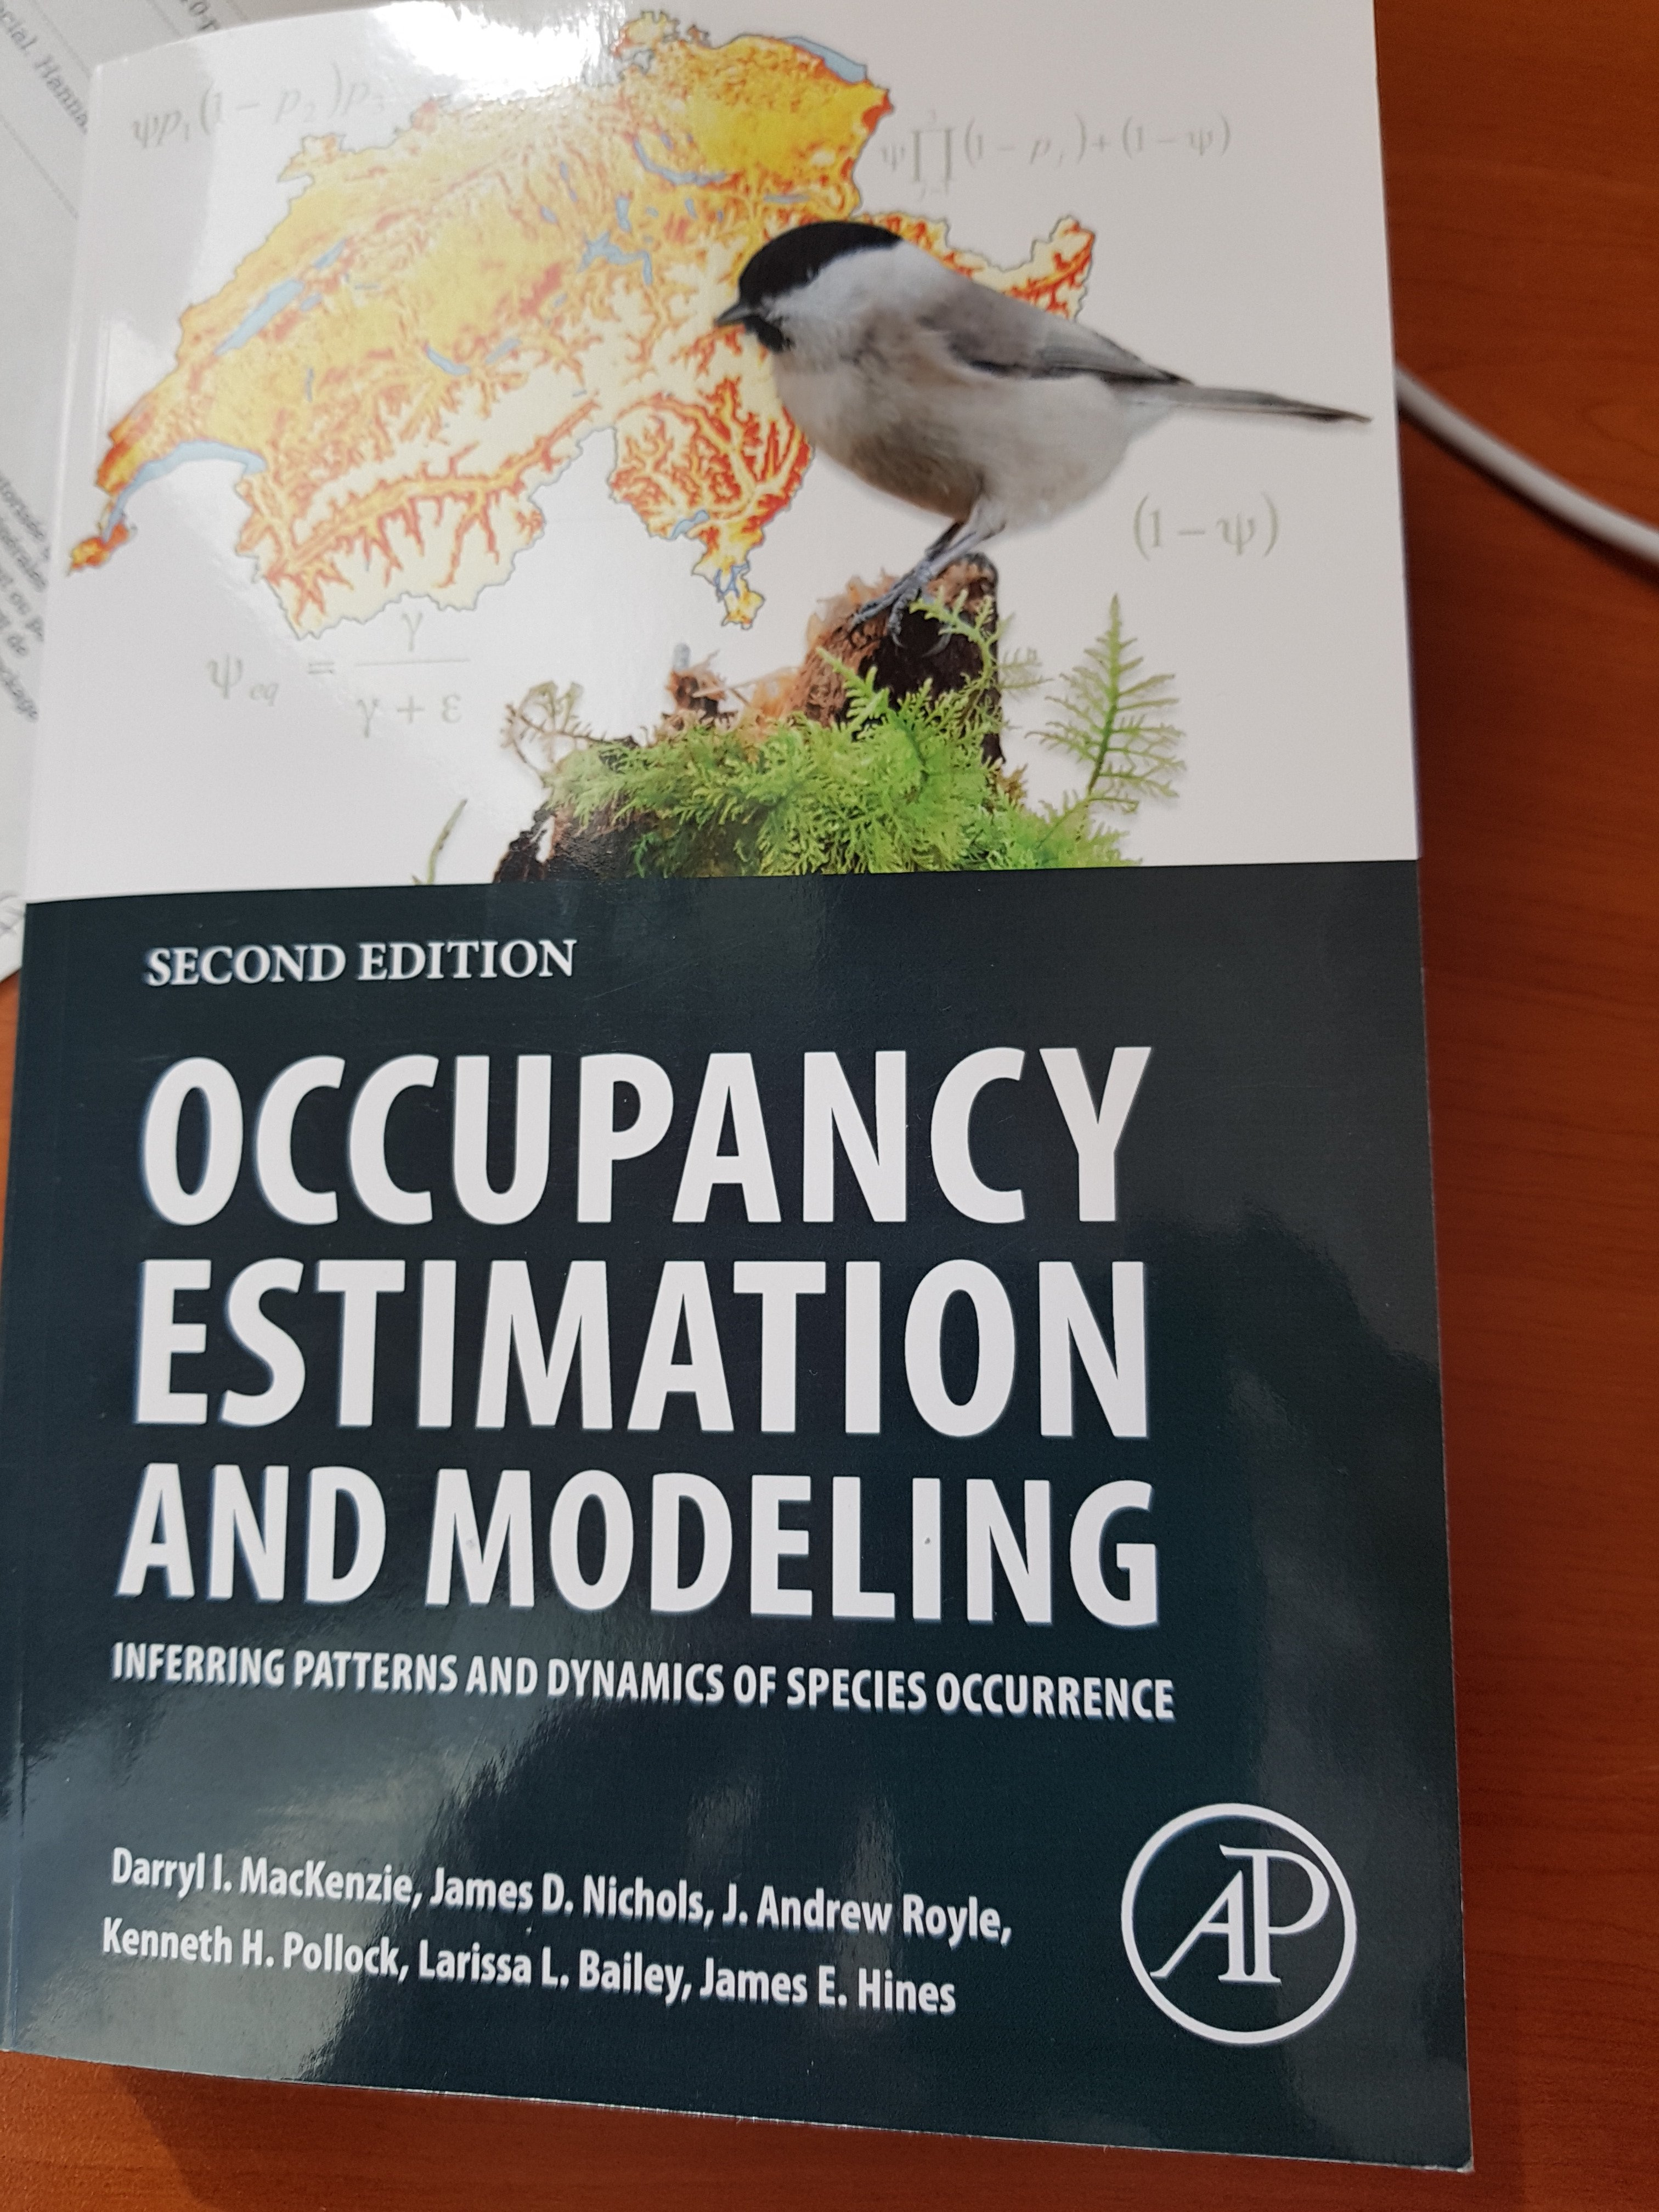

Occupancy models
Notes:
There is a bunch of papers on occupancy models.
Here is a recent example of the use of occupancy models to model species distribution by José, Guru and Brendan.
I also recommend the recent review by Larissa, Darryl and Jim published in MEE.

Slide 10
Occupancy protocol
Several sampling units surveyed
Notes:
So, how do occupancy protocols work? Well you define your study area, then consider several
sampling units to be surveyed, the rectangles here.

Slide 11
Occupancy protocol
1
0
Several sampling units surveyed
Collection of detection/non-detection
0
1
1
0
Notes:
Then you go on the field to collect detection/non-detection data.

Slide 12
Occupancy protocol
1001
0011
Several sampling units surveyed
Collection of detection/non-detection
Replicate surveys in each unit
0000
1011
1111
0000
Notes:
The key is to replicate those surveys in each unit to be able to estimate detection.

Slide 13
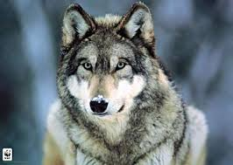
True or false absence?
1001
0011
0000
1011
1111
reality
Notes:
On an example, let’s assume that wolves are distributed this way. With a rectangle here where the species
Is absent, the site is unoccupied, and all the other sites are occupied.

Slide 14
True or false absence?
1001
0011
1001
0011
0000
0000
1011
1011
1111
1111
0000
reality
observation
Notes:
You go on the field, then you get 1’s and 0’s for each of these sites.
For most of these sites, there is at least a detection, but for two sites, we have
exclusively non-detections.

Slide 15
True or false absence?
1001
0011
1001
0011
0000
0000
1011
1011
1111
1111
0000
reality
observation
Notes:
We can then confirm the presence of the species of all sites but the two where we have 0’s only.

Slide 16
True or false absence?
1001
0011
1001
0011
0000
?
1011
1011
1111
1111
?
reality
observation
Notes:
Is the species present at these two sites or not?

Slide 17
Single-season occupancy model likelihood
ψ₁ = prob. a site is initially occupied - occupancy
p = prob. species is detected (given presence) – detection
Notes:
More precisely, the initial states and the observation process are the same as in the dynamic model.
It’s only the state process that is now driven by the identity matrix, meaning that you stay in the state you are initially in.

Slide 18
Single-season occupancy model likelihood
ψ₁ = prob. a site is initially occupied - occupancy
p = prob. species is detected (given presence) – detection
Assuming closure, and independence of surveys:
Pr(1001) = ?
Notes:
Species was present on this specific site, and detected twice, missed twice

Slide 19
Single-season occupancy model likelihood
ψ₁ = prob. a site is initially occupied - occupancy
p = prob. species is detected (given presence) – detection
Assuming closure, and independence of surveys:
Pr(1001) = ψ₁ p (1 – p) (1 – p) p
Notes:
Species was present on this specific site, and detected twice, missed twice

Slide 20
Single-season occupancy model likelihood
ψ₁ = prob. a site is initially occupied - occupancy
p = prob. species is detected (given presence) – detection
Assuming closure, and independence of surveys:
Pr(0000) = ?
Notes:
Species was present on this specific site, and missed twice at every survey; or the species was absent.

Slide 21
Single-season occupancy model likelihood
ψ₁ = prob. a site is initially occupied - occupancy
p = prob. species is detected (given presence) – detection
Assuming closure, and independence of surveys:
Pr(0000) = ψ₁ (1 – p) (1 – p) (1 – p) (1 – p) + (1 - ψ₁)
Notes:
Species was present on this specific site, and missed twice at every survey; or the species was absent.

Slide 22
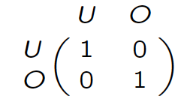
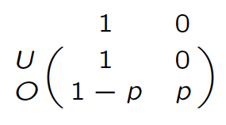
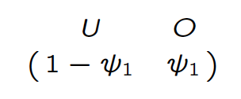
Single-season occupancy model as a HMM
Initial states
Observation process
State process
Markov model
hidden
O = occupied; U = unoccupied
ψ₁ = occupancy, p = detection
Notes:
More precisely, the initial states and the observation process are the same as in the dynamic model.
It’s only the state process that is now driven by the identity matrix, meaning that you stay in the state you are initially in.

Slide 23
Single-season occupancy model as a HMM
Initial states
Observation process
State process
t+1
t
Markov model
hidden
O = occupied; U = unoccupied
ψ₁ = occupancy, p = detection
Notes:
More precisely, the initial states and the observation process are the same as in the dynamic model.
It’s only the state process that is now driven by the identity matrix, meaning that you stay in the state you are initially in.

Slide 24
Single-season occupancy model as a HMM
Initial states
Observation process
State process
t+1
t
t
t
Markov model
hidden
O = occupied; U = unoccupied
ψ₁ = occupancy, p = detection
Notes:
More precisely, the initial states and the observation process are the same as in the dynamic model.
It’s only the state process that is now driven by the identity matrix, meaning that you stay in the state you are initially in.

Slide 25
Dynamic (multi-season) occupancy models
extinction
O
U
ε
O = occupied; U = unoccupied
Notes:
This is what occupancy models have been designed for.
How does a occupancy model work? Let’s focus on a dynamic occupancy model and let’s assume that we have perfect detection.
We consider a site between t and t + 1.
for example, you can go from an occupied site to an unoccupied site - this is the extinction process driven by the extinction prob epsilon.

Slide 26
Dynamic (multi-season) occupancy models
1 = species detected; 0 = species undetected
1
0
1
p
1-p
p
extinction
O
U
ε
O = occupied; U = unoccupied
Notes:
Now we relax the assumption of perfect detection and we assume that we do three visits.
Then the species goes detected or non-detected with probability p or 1-p.

Slide 27
Dynamic (multi-season) occupancy models
1 = species detected; 0 = species undetected
1
0
1
0
0
0
p
1-p
p
1
1
1
extinction
O
U
ε
O = occupied; U = unoccupied
Notes:
Of course, if the site is in state unoccupied, then the species goes undetected at all visits for sure.

Slide 28
Dynamic (multi-season) occupancy models
1 = species detected; 0 = species undetected
0
0
0
1
1
0
1
1
1
p
p
1-p
colonization
U
O
γ
O = occupied; U = unoccupied
Notes:
Now if the site is first unoccupied then occupied, we have the colonization process driven by the colonization prob gamma.

Slide 29
Dynamic (multi-season) occupancy models
ψ₁ = prob. a site is occupied - occupancy
p = prob. species is detected (given presence) – detection
γ = prob. unoccupied site becomes occupied – colonisation
ε = prob. occupied site becomes unoccupied – extinction

Slide 30
Dynamic occupancy model likelihood
ψ₁ = occupancy
p = detection
γ = colonisation
ε = extinction
Pr(110 000) = ?
Notes:
– Site occupied in season 1, and species detected in surveys 1 and 2, and
missed in survey 3.
– Between seasons 1 and 2 the site continued occupied and the species
was not detected in any of the three surveys OR the species became
locally extinct

Slide 31
Dynamic occupancy model likelihood
ψ₁ = occupancy
p = detection
γ = colonisation
ε = extinction
Pr(110 000) =
Three replicated surveys or secondary occasions
Closure assumption
Notes:
– Site occupied in season 1, and species detected in surveys 1 and 2, and
missed in survey 3.
– Between seasons 1 and 2 the site continued occupied and the species
was not detected in any of the three surveys OR the species became
locally extinct

Slide 32
Dynamic occupancy model likelihood
ψ₁ = occupancy
p = detection
γ = colonisation
ε = extinction
Pr(110 000) = ψ₁ p p (1 – p)
Three replicated surveys or secondary occasions
Closure assumption
Notes:
– Site occupied in season 1, and species detected in surveys 1 and 2, and
missed in survey 3.
– Between seasons 1 and 2 the site continued occupied and the species
was not detected in any of the three surveys OR the species became
locally extinct

Slide 33
Dynamic occupancy model likelihood
ψ₁ = occupancy
p = detection
γ = colonisation
ε = extinction
Pr(110 000) = ψ₁ p p (1 – p) [ ε + (1 – ε) … ]
Notes:
– Site occupied in season 1, and species detected in surveys 1 and 2, and
missed in survey 3.
– Between seasons 1 and 2 the site continued occupied and the species
was not detected in any of the three surveys OR the species became
locally extinct

Slide 34
Dynamic occupancy model likelihood
ψ₁ = occupancy
p = detection
γ = colonisation
ε = extinction
Pr(110 000) = ψ₁ p p (1 – p) [ ε + (1 – ε) (1 – p) (1 – p) (1 – p) ]
Notes:
– Site occupied in season 1, and species detected in surveys 1 and 2, and
missed in survey 3.
– Between seasons 1 and 2 the site continued occupied and the species
was not detected in any of the three surveys OR the species became
locally extinct

Slide 35
Dynamic occupancy model likelihood
ψ₁ = occupancy
p = detection
γ = colonisation
ε = extinction
Pr(000 010) = ?
Notes:
– Site occupied in season 1, and species detected in surveys 1 and 2, and
missed in survey 3.
– Between seasons 1 and 2 the site continued occupied and the species
was not detected in any of the three surveys OR the species became
locally extinct

Slide 36
Dynamic occupancy model likelihood
ψ₁ = occupancy
p = detection
γ = colonisation
ε = extinction
Pr(000 010) = [ ψ₁ (1 – p) (1 – p) (1 – p) (1 – ε) + (1 – ψ₁) γ ]
Notes:
– Site occupied in season 1, and species detected in surveys 1 and 2, and
missed in survey 3.
– Between seasons 1 and 2 the site continued occupied and the species
was not detected in any of the three surveys OR the species became
locally extinct

Slide 37
Dynamic occupancy model likelihood
ψ₁ = occupancy
p = detection
γ = colonisation
ε = extinction
Pr(000 010) = [ ψ₁ (1 – p) (1 – p) (1 – p) (1 – ε) + (1 – ψ₁) γ ]
x (1 – p) p (1 – p)
Notes:
– Site occupied in season 1, and species detected in surveys 1 and 2, and
missed in survey 3.
– Between seasons 1 and 2 the site continued occupied and the species
was not detected in any of the three surveys OR the species became
locally extinct

Slide 38
Derived parameters
ψ₁ = occupancy
p = detection
γ = colonisation
ε = extinction
Season-specific occupancy:
ψ_{t+1} = ψ_{t} (1 – ε_{t}) + (1 – ψ_{t}) γ_{t}
Rate of change in occupancy:
λ_{t} = ψ_{t+1} / ψ_{t}
Notes:
– Site occupied in season 1, and species detected in surveys 1 and 2, and
missed in survey 3.
– Between seasons 1 and 2 the site continued occupied and the species
was not detected in any of the three surveys OR the species became
locally extinct

Slide 39
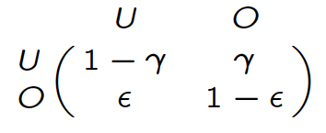
Dynamic occupancy model as a HMM
Initial states
Observation process
State process
Markov model
hidden
Notes:
In a more formal waywe will use a hidden markov formulation of occupancy models for which you need is 3 ingredients;
1. The initial states, here you’re either unoccupied or occupied.
2. Then you have a Markov chain for the dynamic of the states from time t in row to t+1 in columns. This Markov chain is driven by the extinction and colonization probs.
For example, the prob of being occupied at t+1 given that you were unoccupied at t is gamma the colonization prob.
3. Finally, you add an extra layer to specify the link between the observations, non-detected or detected and the states, unoccupied or occupied.
For example, if the site is occupied, then the species is detected with prob p.

Slide 40
Single-season is a particular case of multi-season
No colonization (γ = 0) and no extinction (ε = 0)
Initial states
Observation process
State process
Notes:
From there, it’s quite easy to derive a formulation for the simpler single season occupancy models.
You just need to impose no extinction and no colonisation in the state process.

Slide 41


Slide 42


Slide 43


Lecture 2 Heterogeneity
Occupancy crash course (OCC)
Notes:
Today I’m gonna talk about SDM obviously, and a particular class of occupancy models that have been specifically designed to
account for the imperfect detection of species.
This is joint work with several colleagues, some of them from the French Game and Wildlife Agency and others from the CEFE, including two
very clever PhD students of mine : Julie and Laetitia.

Slide 44
Key occupancy model assumptions
Independent detections
No unmodelled heterogeneity
No false positives
Notes:
As any statistical model, they rely on assumptions that need to be fullfilled for safe inference.

Slide 45
Lecture 4 Occupancy models with species misidentification
Occupancy crash course (OCC)
Notes:
Today I’m gonna talk about SDM obviously, and a particular class of occupancy models that have been specifically designed to
account for the imperfect detection of species.
This is joint work with several colleagues, some of them from the French Game and Wildlife Agency and others from the CEFE, including two
very clever PhD students of mine : Julie and Laetitia.

Slide 46

Species misidentification
2013
How to account for false positives due to species misidentification?

Slide 47
Data
Observations by hunters (phone interviews); uncertainty in species identification
Telemetry;
no doubt about species
Habitat quality
Notes:
Uncertainty due to inexperience of some hunters, sensitivity of hunters to controversies about wolf management

Slide 48
Reminder: static occupancy model
Initial states
Observation process
State process
Notes:
More precisely, the initial states and the observation process are the same as in the dynamic model.
It’s only the state process that is now driven by the identity matrix, meaning that you stay in the state you are initially in.

Slide 49
Model allowing for false positives
Observation process
0
1
2
Uncertain detection
Detection with no doubt about the species
Notes:
More precisely, the initial states and the observation process are the same as in the dynamic model.
It’s only the state process that is now driven by the identity matrix, meaning that you stay in the state you are initially in.

Slide 50
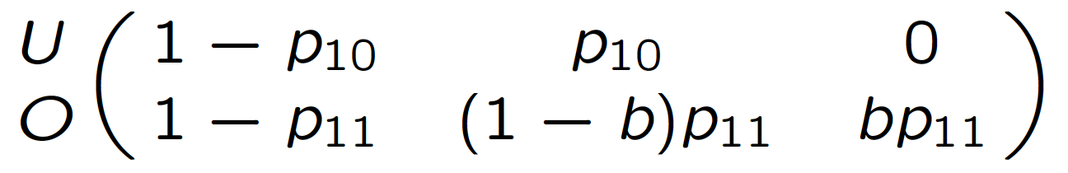
Model allowing for false positives
Observation process
0
1
2
p₁₀ = probability of false positive detection
Notes:
More precisely, the initial states and the observation process are the same as in the dynamic model.
It’s only the state process that is now driven by the identity matrix, meaning that you stay in the state you are initially in.

Slide 51
Model allowing for false positives
Observation process
0
1
2
p₁₁ = probability of detection
b = probability that a detection is classified as unambiguous
Notes:
More precisely, the initial states and the observation process are the same as in the dynamic model.
It’s only the state process that is now driven by the identity matrix, meaning that you stay in the state you are initially in.

Slide 52
Estimates of occupancy for gray wolves in northern Montana from 2007–2010
Notes:
False negatives led to underestimation of occupancy,

Slide 53
Estimates of occupancy for gray wolves in northern Montana from 2007–2010
Notes:
while false positives led to over-estimation of occupancy,

Slide 54
Lecture 5 Estimating co-occurrence of interacting species
Occupancy crash course (OCC)
Notes:
Today I’m gonna talk about SDM obviously, and a particular class of occupancy models that have been specifically designed to
account for the imperfect detection of species.
This is joint work with several colleagues, some of them from the French Game and Wildlife Agency and others from the CEFE, including two
very clever PhD students of mine : Julie and Laetitia.

Slide 55
Rationale
Several (say 2) different species on a site
Interactions affect occupancy probabilities
Detection of a species affected by presence of another one: blurred interactions
Examples: predation, mutualism, competition, …
Occupancy of a species when other species is present?
Notes:
Do some species tend to occur more (or less) often together than expected?
A great deal of literature has been published during past 30 years on methods for assessing patterns of co-occurrence, but not accounting for detectability.

Slide 56
States
U = site unoccupied
A = site occupied by species A only
B = site occupied by species B only
AB = site occupied by both species
Notes:
Do some species tend to occur more (or less) often together than expected?
A great deal of literature has been published during past 30 years on methods for assessing patterns of co-occurrence, but not accounting for detectability.

Slide 57
State process
ψ^{Α} = prob. a site is occupied by species A
ψ^{Β} = prob. a site is occupied by species B
ψ^{ΑΒ} = prob. a site is occupied by species A and B
Notes:
Do some species tend to occur more (or less) often together than expected?
A great deal of literature has been published during past 30 years on methods for assessing patterns of co-occurrence, but not accounting for detectability.

Slide 58
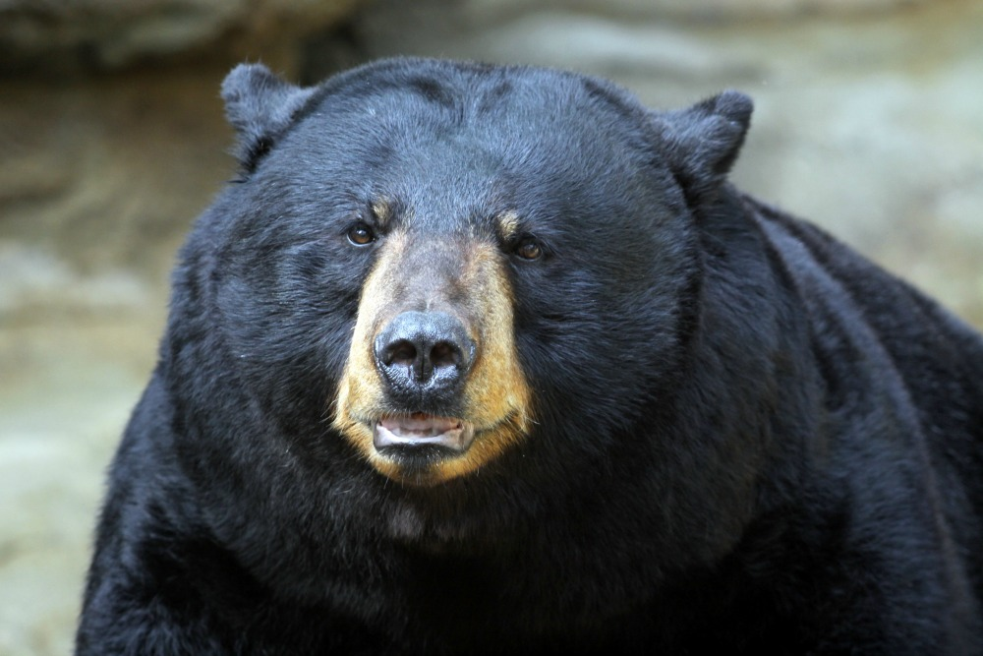
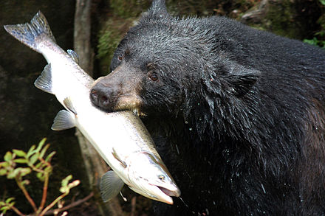
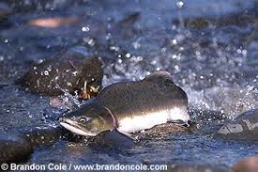
Venn diagram
Occupied by species A only
Occupied by both species
Occupied by species B only
ψ^{Α} – ψ^{ΑΒ}
ψ^{ΑΒ}
ψ^{Β} – ψ^{ΑΒ}
Site unoccupied with prob.: 1 – ψ^{Α} – ψ^{Β} + ψ^{ΑΒ}
Notes:
Do some species tend to occur more (or less) often together than expected?
A great deal of literature has been published during past 30 years on methods for assessing patterns of co-occurrence, but not accounting for detectability.

Slide 59
Events
0 = species undetected
1 = A detected
2 = B detected
3 = both species detected
Notes:
Do some species tend to occur more (or less) often together than expected?
A great deal of literature has been published during past 30 years on methods for assessing patterns of co-occurrence, but not accounting for detectability.

Slide 60
Observation process
p^{A} = prob. detecting species A given only species A is present
p^{B} = prob. detecting species B given only species B is present
r^{AB} = prob. detecting both species A and B when both present
r^{Ab} = prob. detecting species A but not B when both present
r^{aB} = prob. detecting species B but not A when both present
r^{ab} = prob. detecting neither species when both present
Notes:
Do some species tend to occur more (or less) often together than expected?
A great deal of literature has been published during past 30 years on methods for assessing patterns of co-occurrence, but not accounting for detectability.

Slide 61
Hidden Markov model – part 1
Initial states
U A B AB
Notes:
More precisely, the initial states and the observation process are the same as in the dynamic model.
It’s only the state process that is now driven by the identity matrix, meaning that you stay in the state you are initially in.

Slide 62
Hidden Markov model – part 2
State process
U A B AB
U
A
B
AB
Notes:
More precisely, the initial states and the observation process are the same as in the dynamic model.
It’s only the state process that is now driven by the identity matrix, meaning that you stay in the state you are initially in.

Slide 63
Hidden Markov model – part 3
Observation process
0 1 2 3
U
A
B
AB
Notes:
More precisely, the initial states and the observation process are the same as in the dynamic model.
It’s only the state process that is now driven by the identity matrix, meaning that you stay in the state you are initially in.

Slide 64
Quantifying interactions
Interaction estimated by: η = ψ^{AB} / (ψ^{A} ψ^{B})
< 1 – avoidance (less frequent than expected)
> 1 – convergence (more frequent than expected)
= 1 – independence (ψ^{AB} = ψ^{A} ψ^{B})
Notes:
More precisely, the initial states and the observation process are the same as in the dynamic model.
It’s only the state process that is now driven by the identity matrix, meaning that you stay in the state you are initially in.

Slide 65
Alternative parameterization
Introduce conditional probabilities
Notes:
More precisely, the initial states and the observation process are the same as in the dynamic model.
It’s only the state process that is now driven by the identity matrix, meaning that you stay in the state you are initially in.

Slide 66
Hidden Markov model – part 1 modified
Initial states, in 2 steps
U A B AB
no-B B
Notes:
More precisely, the initial states and the observation process are the same as in the dynamic model.
It’s only the state process that is now driven by the identity matrix, meaning that you stay in the state you are initially in.

Slide 67
Testing interactions
A and B independent?
Notes:
More precisely, the initial states and the observation process are the same as in the dynamic model.
It’s only the state process that is now driven by the identity matrix, meaning that you stay in the state you are initially in.

Slide 68
Lecture 6 Conclusions
Occupancy crash course (OCC)
Notes:
Today I’m gonna talk about SDM obviously, and a particular class of occupancy models that have been specifically designed to
account for the imperfect detection of species.
This is joint work with several colleagues, some of them from the French Game and Wildlife Agency and others from the CEFE, including two
very clever PhD students of mine : Julie and Laetitia.

Slide 69
Conclusions
1. (Almost?) all occupancy models in a unified HMM framework
Single-season, dynamic models
Mixture/random effects and multistate models to account for heterogeneity
False-positives
Species interactions
Notes:
What are the advantages of the HMM formulation of occupancy models?
The first big advantage is that we now have a unified framework in which we can basically fit all occupancy models:
The other big advantage is that, with HMM, we have a formal link between the capture-recapture and occupancy worlds,
and this link might reveal very useful for occupancy models, and vice versa obviously!

Slide 70
Conclusions
2. HMM: link occupancy and capture-recapture communities
Goodness-of-fit
Accounting for lack of dependence
Notes:
What are the advantages of the HMM formulation of occupancy models?
The first big advantage is that we now have a unified framework in which we can basically fit all occupancy models:
The other big advantage is that, with HMM, we have a formal link between the capture-recapture and occupancy worlds,
and this link might reveal very useful for occupancy models, and vice versa obviously!

Slide 71
Conclusions
3. There is a learning curve to understand HMM, is it worth it?
HMM is a general framework
All models can be obtained as particular cases (?)
Notes:
What are the advantages of the HMM formulation of occupancy models?
The first big advantage is that we now have a unified framework in which we can basically fit all occupancy models:
The other big advantage is that, with HMM, we have a formal link between the capture-recapture and occupancy worlds,
and this link might reveal very useful for occupancy models, and vice versa obviously!

Slide 72

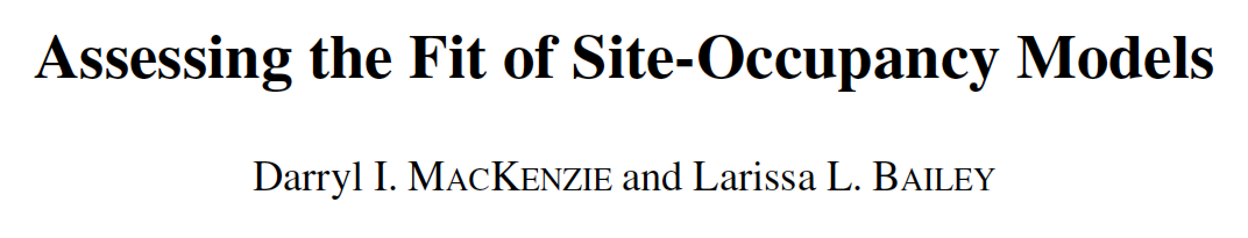
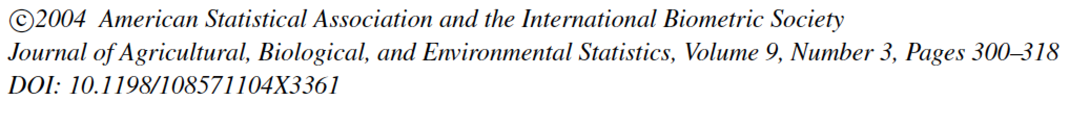
What we did not cover
How to choose sites? Occasions?
site selection
allocation of effort
design comparisons
survey timing
Goodness-of-fit testing
A few other models…
habitat and species occurrence dynamics, multistate, heterogeneity, …
Notes:
What are the advantages of the HMM formulation of occupancy models?
The first big advantage is that we now have a unified framework in which we can basically fit all occupancy models:
The other big advantage is that, with HMM, we have a formal link between the capture-recapture and occupancy worlds,
and this link might reveal very useful for occupancy models, and vice versa obviously!

